Slide 1

Homicidal Relations
Cory Mills and Tina Habib

Slide 2

Methodology
Collection of Statistical Data
  Racial and Ethnic Differences
  Socioeconomic Living Conditions
  Focus on Lee County
Bivariate Correlation Analysis
  Statewide Patterns
How does Lee County fit in?

Slide 3

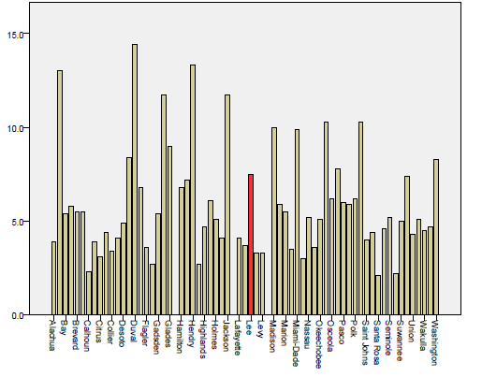
Where does Lee County Stand?
Homicide Rate per 100,000

Slide 4

Bivariate Correlation Analysis
Homicide rate in 2008 (per 100,000)
Population of Racial and Ethnic Groups
Education Levels
Unemployment Rates
Household Income Levels
Median Age
Percentage of Urban Populations
Percentage of Owner-occupied Housing
Percentage below Poverty Level

Slide 5
Bivariate Correlation Analysis
Homicide rate in 2008 (per 100,000)
Population of Racial and Ethnic Groups
Education Levels
Unemployment Rates
Household Income Levels
Median Age
Percentage of Urban Populations
Percentage of Owner-occupied Housing
Percentage below Poverty Level
    Negetive Correlation
      Positive Correlation
  Negative Correlation
              Negative Correlation

Slide 6

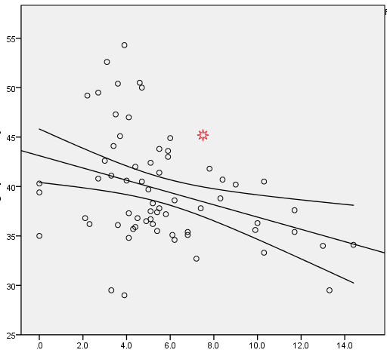
Median Age
Graying Population
Migration of Money
Infrastructure
Increased cost of Living
Median Age (in yrs)
Homicide Rate by County (per 100,000)
r² = 0.116

Slide 7

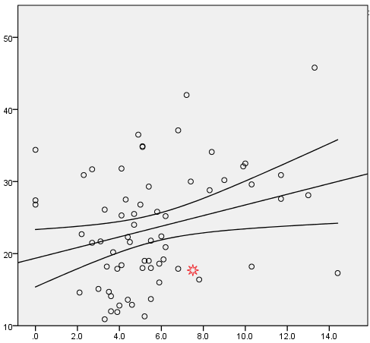
Education Level (LHSD)
% Population with less than an HS Diploma
Confusing Chart!
Racial Component
Socioeconomic Indicator
Homicide Rate by County (per 100,000)
r² = 0.079

Slide 8

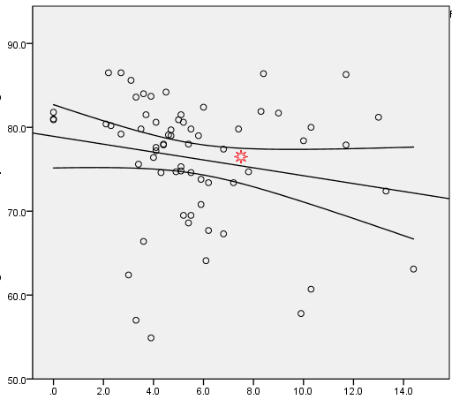
Owner-Occupied Housing (OOH)
Socioeconomic Indicator
Stress Level Indicator
% Owner-Occupied Housing
Homicide Rate by County (per 100,000)
r² = 0.037

Slide 9

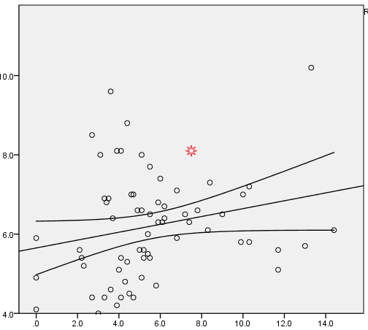
Unemployment
Socioeconomic (again)
Lee County has high rates
Unemployment Rate 2008
Homicide Rate by County (per 100,000)
r² = 0.051

Slide 10

State and National Comparison
 | Homicide Rate per 100,000 | % No GED | Unemployment Rate | Median Age | % Owner-Occupied Housing
U.S | 5.0 | ~15 | 5.8 | 36.8 | 67.8
Florida | 6.8 | 20.1 | 6.2 | 38.7 | 70.3
Lee | 7.5 | 17.7 | 8.1 | 45.2 | 74.9

Slide 11

County Comparison
 | Homicide Rate per 100,000 | % No GED | Unemployment Rate | Median Age | % Owner-Occupied Housing
Lee | 7.5 | 17.7 | 8.1 | 45.2 | 74.9
Brevard | 5.5 | 13.7 | 6.5 | 41.4 | 76.9
Pasco | 6 | 22.4 | 7.4 | 44.9 | 77.7
Polk | 6.2 | 25.2 | 6.7 | 38.6 | 70.9
Seminole | 5.2 | 11.3 | 5.6 | 36.2 | 71.1
Volusia | 5.1 | 18 | 6.6 | 42.4 | 75.9

Slide 12
Why is the Lee County Homicide Rate so High?
BAD!
High Unemployment
?
High Education
GOOD!
High OOH
?
Graying Population
?
?
?

Slide 13

Dangers of Demographic Shift!

Slide 14

Correlations Between Variables
 | Unemployment | % Less than High School Diploma | Median Age
% Less than High School Diploma | r = 0.113 s = 0.362
Median Age | r = 0.459 s = 0.000 | r = - 0.304 s = 0.012
% Owner-Occupied Housing | r = 0.260 s = 0.033 | r = 0.306 s = 0.012 | r = 0.517 s = 0.000

Slide 15

Consequences of a Gray Population
Artificially Inflated Median Household Income
Higher Property Cost
Higher General Cost of Living
Higher Unemployment
Gentrification

Slide 16
Fin

